Slide 1
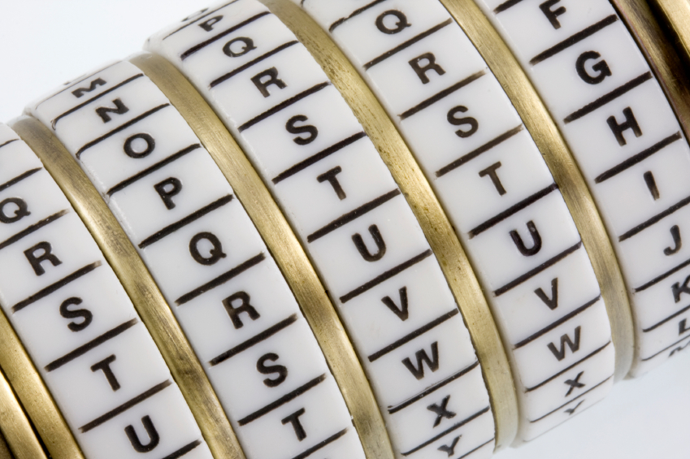
Cryptography
Corporate Computer Security, 4th Edition
Randall J. Boyle & Raymond R. Panko
Chapter 3

Slide 2
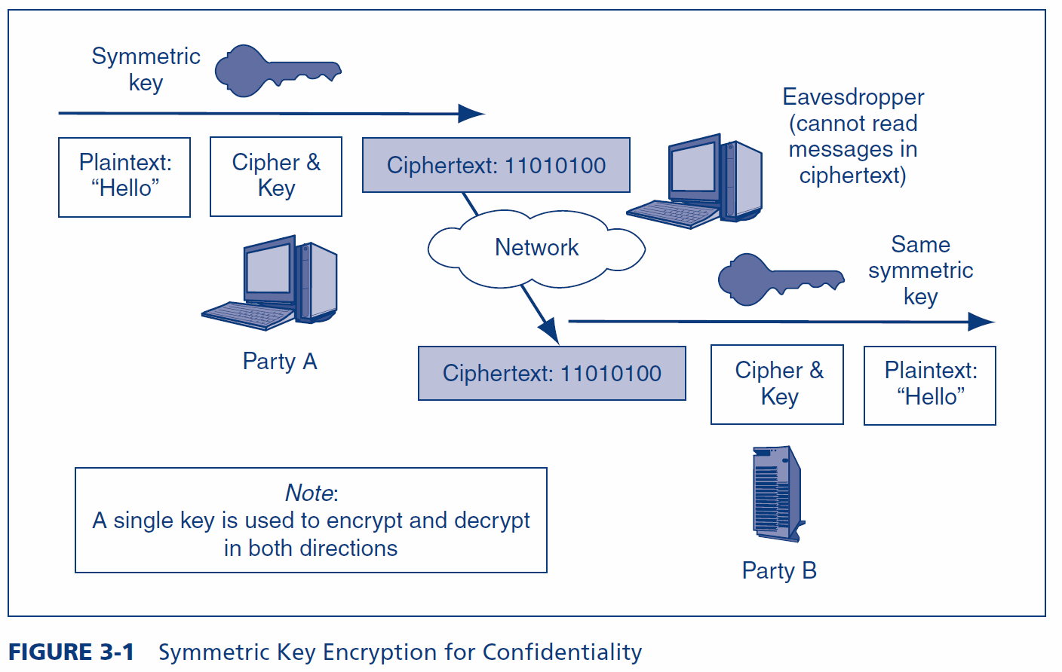
Symmetric Key Encryption for Confidentiality

Slide 3
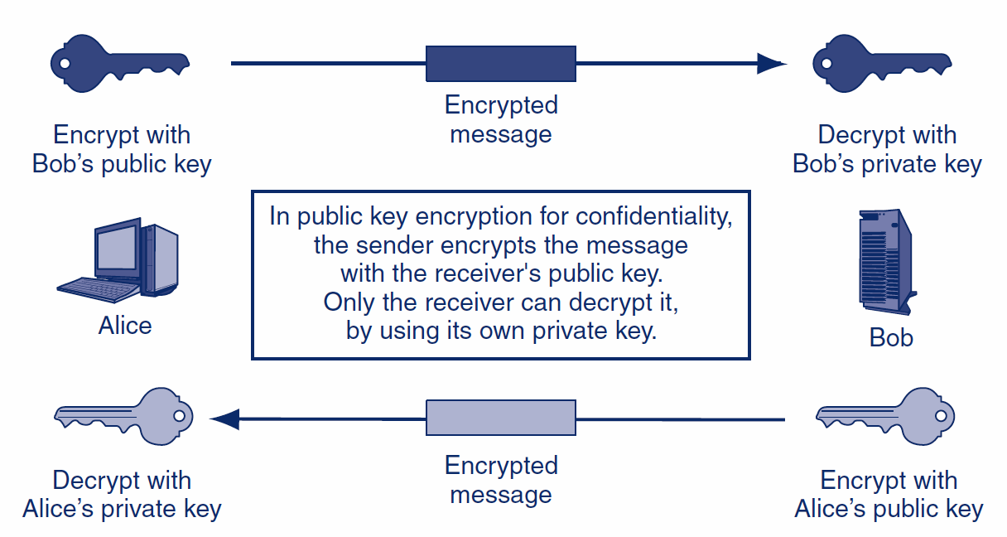
Public Key Encryption for Confidentiality

Slide 4
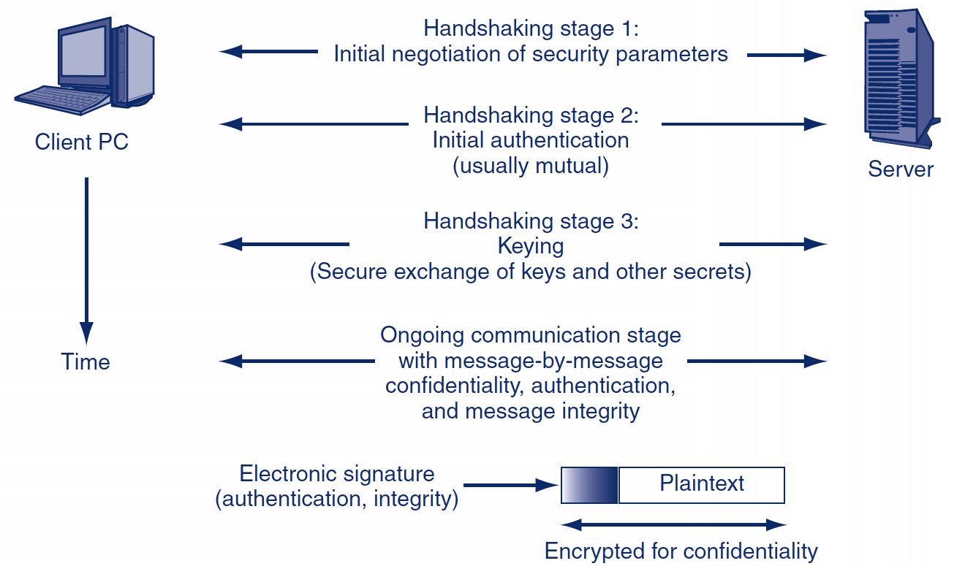
3.3: Cryptographic System Stages

Slide 5
HS Stage 1: Cipher Suites
Cipher Suite | Key Negotiation | Digital Signature Method | Symmetric Key Encryption Method | Hashing Method for HMAC | Strength
NULL_WITH_NULL_NULL | None | None | None | None | None
RSA_EXPORT_WITH_ RC4_40_MD5 | RSA export strength (40 bits) | RSA export strength (40 bits) | RC4 (40-bit key) | MD5 | Weak
RSA_WITH_DES_CBC_ SHA | RSA | RSA | DES_CBC | SHA-1 | Stronger but not very strong
DH_DSS_WITH_3DES_ EDE_CBC_SHA | Diffie-Hellman | Digital Signature Standard | 3DES_ EDE_CBC | SHA-1 | Strong
RSA_WITH_AES_256_CBC_SHA256 | RSA | RSA | AES 256 bits | SHA-256 | Very strong

Slide 6
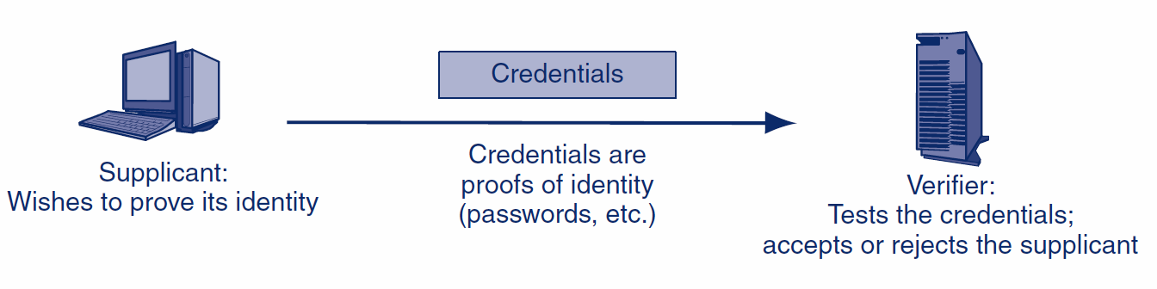
HS Stage 2: Authentication

Slide 7
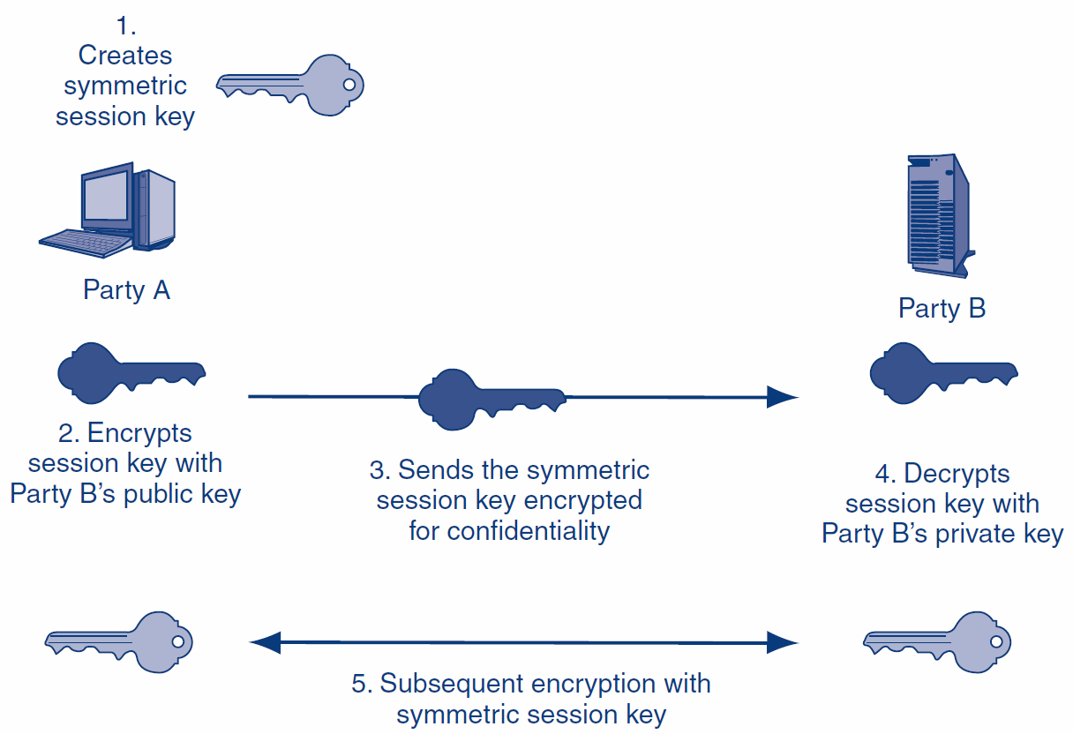
HS Stage 3: Keying

Slide 8
Learning Objectives
Explain how electronic signatures, including digital signatures, digital certificates, and key-hashed message authentication codes (HMACs) work.
Describe public key encryption for authentication.
Describe quantum security.
Explain cryptographic systems including VPNs, SSL, and IPsec.

Slide 9
Stage 4: Ongoing Communication
Selecting methods and parameters
Authentication
Keying (the secure exchange of secrets)
Ongoing communication

Slide 10
3.7: Ongoing Communication
Consumes nearly all of the dialogues
Message-by-Message Encryption
Nearly always uses symmetric key encryption
Public key encryption is too inefficient
Message-by-Message Authentication
Digital signatures
Message authentication codes (MACs)
Also provide message-by-message integrity

Slide 11
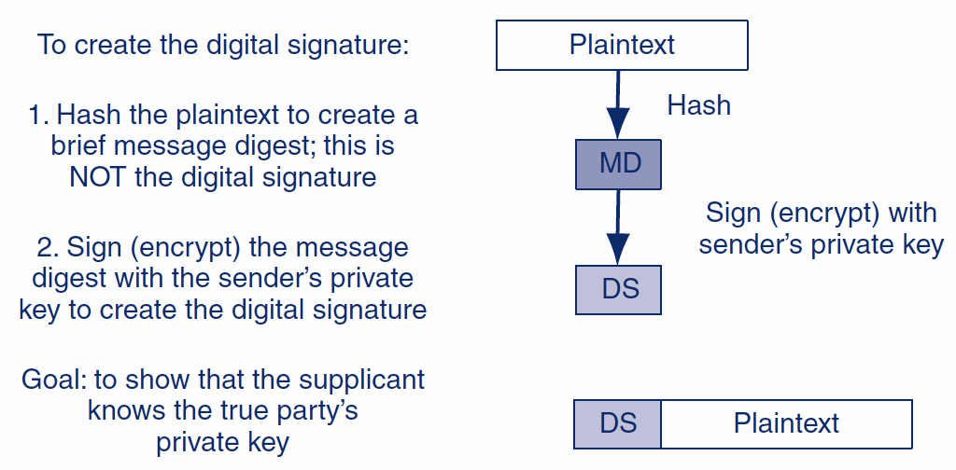
3.7: Digital Signature for Message-by-Message Authentication

Slide 12
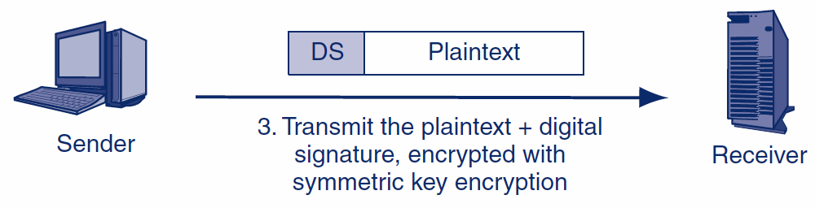
3.7: Digital Signature for Message-by-Message Authentication
Encryption is done to protect the plaintext.
It is not needed for message-by-message authentication.

Slide 13
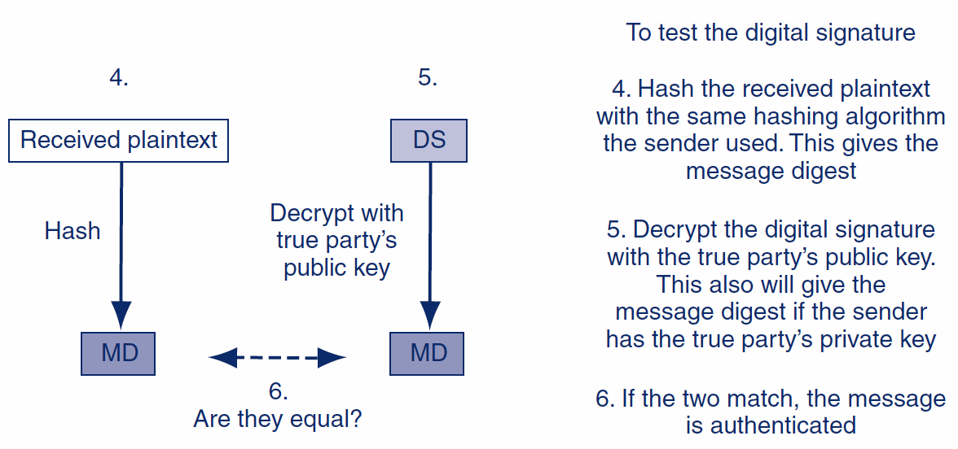
3.7: Digital Signature for Message-by-Message Authentication (The diagram is not necessarily correct)

Slide 14
3.7: Public Key Encryption for Confidentiality and Authentication
Public Key Encryption Goal | Sender Encrypts with | Receiver Decrypts with
Confidentiality | The receiver’s public key | The receiver’s private key
Authentication | The sender’s private key | The True Party’s public key (not the sender’s public key)
Point of frequent confusion

Slide 15
3.7: Finding the True Party’s Public Key
Cannot use the sender’s public key
It would always “validate” the sender’s digital signature
Normally requires a digital certificate
File provided by a certificate authority (CA)
The certificate authority must be trustworthy
Digital certificate provides the subject’s (True Party’s) name and public key
Don’t confuse digital signatures and the digital certificates used to test digital signatures!

Slide 16
3.7: X.509 Digital Certificate Fields
Field | Description
Version Number | Version number of the X.509 standard. Most certificates follow Version 3. Different versions have different fields. This figure reflects the Version 3 standard.
Issuer | Name of the Certificate Authority (CA).
Serial Number | Unique serial number for the certificate, set by the CA.
Subject (True Party) | The name of the person, organization, computer, or program to which the certificate has been issued. This is the true party.
Public Key | The public key of the subject (the true party).
Public Key Algorithm | The algorithm the subject uses to sign messages with digital signatures.
Serial number allows the receiver to check if the digital certificate has been revoked by the CA.
Certificate provides the True Party’s public key.

Slide 17
3.7: X.509 Digital Certificate Fields
Field | Description
Digital Signature | The digital signature of the certificate, signed by the CA with the CA’s own private key. For testing certificate authentication and integrity. User must know the CA’s public key independently.
Signature Algorithm Identifier | The digital signature algorithm the CA uses to sign its certificates.
Other Fields | …
The CA signs the cert with its own private key so that the cert’s validity can be checked for alterations.

Slide 18
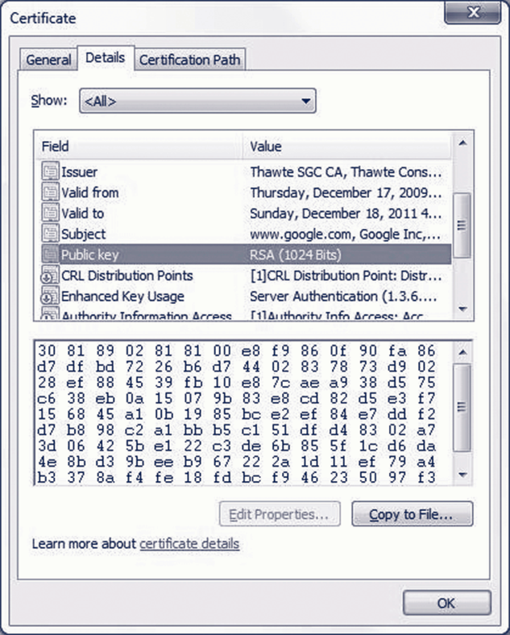
3.7: Digital certificate for Google.com

Slide 19
3.7: Verifying the Digital Certificate
Testing the Digital Signature
The digital certificate has a digital signature of its own
Signed with the Certificate Authority’s (CA’s) private key
Must be tested with the CA’s well-known public key
If the test works, the certificate is authentic and unmodified

Slide 20
3.7: Verifying the Digital Certificate
Checking the Valid Period
Certificate is valid only during the valid period in the digital certificate (not shown in the figure)
If the current time is not within the valid period, reject the digital certificate

Slide 21
3.7: Verifying the Digital Certificate
Checking for Revocation
Certificates may be revoked for improper behavior or other reasons
Revocation must be tested
Cannot be done by looking at fields within the certificate
Receiver must check with the CA

Slide 22
3.7: Verifying the Digital Certificate
Checking for Revocation
Verifier may download the entire certificate revocation list from the CA
See if the serial number is on the certificate revocation list
If so, do not accept the certificate
Or the verifier may send a query to the CA
Requires the CA to support the Online Certificate Status Protocol

Slide 23
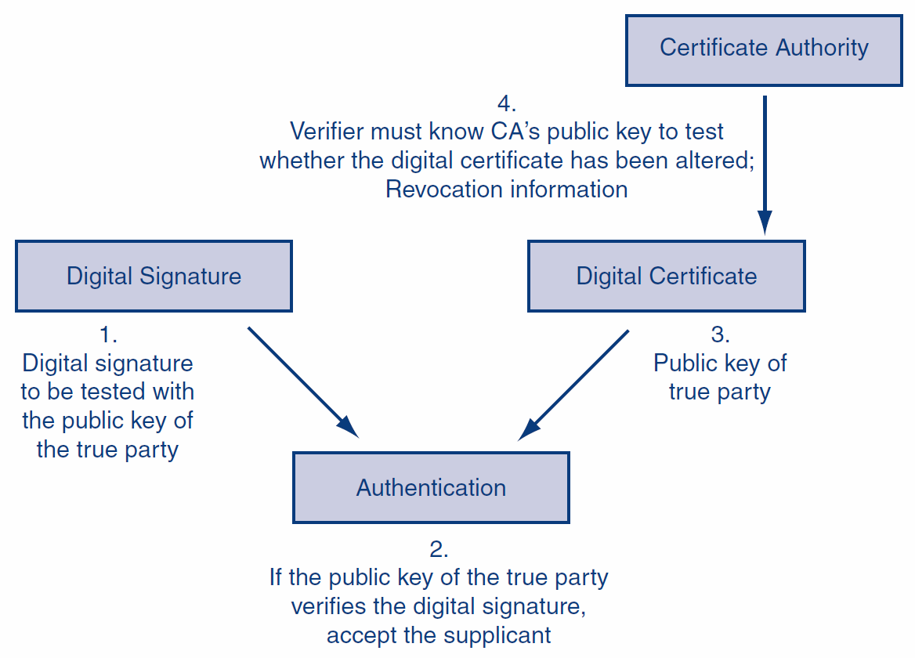
3.7: Digital Signature and Digital Certificate in Authentication (overview)

Slide 24
3.7: Message-by-Message Authentication
Also Brings Message Integrity
If the message has been altered, the authentication method will fail automatically
Digital Signature Authentication
Uses public key encryption for authentication
Very strong but expensive
Key-Hashed Message Authentication Codes
An alternate authentication method using hashing
Much less expensive than digital signature authentication
Much more widely used

Slide 25
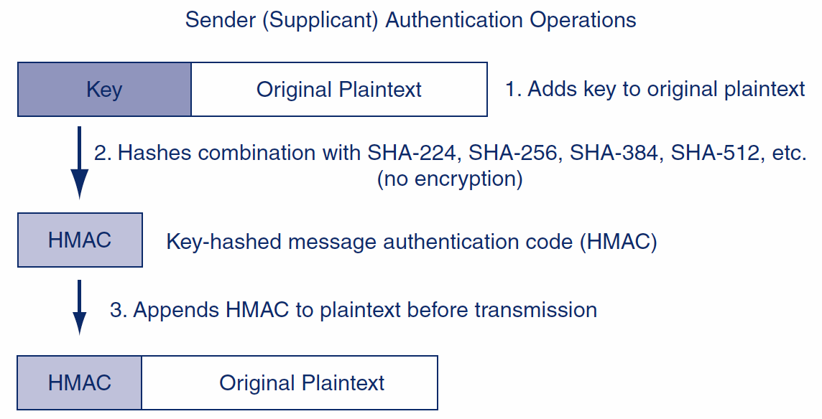
3.7: Key-Hashed Message Authentication Code (HMAC)

Slide 26
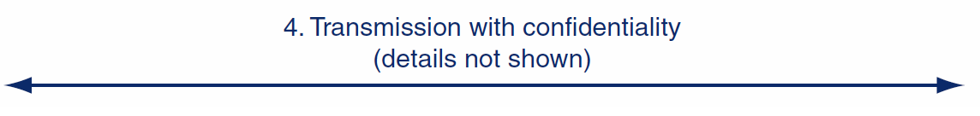
3.7: Key-Hashed Message Authentication Code (HMAC)
As in the case of digital signatures, confidentiality is done to protect the plaintext.
It is not needed for authentication and has nothing to do with authentication.

Slide 27
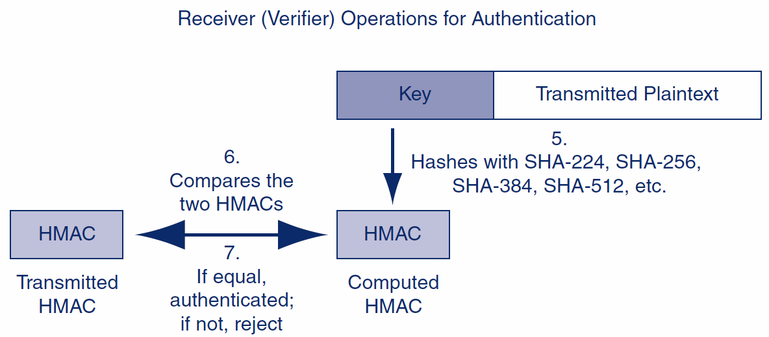
3.7: Key-Hashed Message Authentication Code (HMAC)

Slide 28
Recall: HMAC Hash Method Agree in HS1
Cipher Suite | Key Negotiation | Digital Signature Method | Symmetric Key Encryption Method | Hashing Method for HMAC | Strength
NULL_WITH_NULL_NULL | None | None | None | None | None
RSA_EXPORT_WITH_ RC4_40_MD5 | RSA export strength (40 bits) | RSA export strength (40 bits) | RC4 (40-bit key) | MD5 | Weak
RSA_WITH_DES_CBC_ SHA | RSA | RSA | DES_CBC | SHA-1 | Stronger but not very strong
DH_DSS_WITH_3DES_ EDE_CBC_SHA | Diffie-Hellman | Digital Signature Standard | 3DES_ EDE_CBC | SHA-1 | Strong
RSA_WITH_AES_256_CBC_SHA256 | RSA | RSA | AES 256 bits | SHA-256 | Very strong

Slide 29
3.7: Nonrepudiation
Nonrepudiation means that the sender cannot deny that he or she sent a message
With digital signatures, the sender must use his or her private key
It is difficult to repudiate that you sent something if you use your private key
With HMACs, both parties know the key used to create the HMAC
The sender can repudiate the message, claiming that the receiver created it

Slide 30
3.7: Nonrepudiation
Packet-level nonrepudiation is unimportant in most cases
The application message—an e-mail message, a contract, etc.—is the important thing
If the application layer message has its own digital signature, you have nonrepudiation for the application message, even if you use HMACs at the internet layer for packet authentication

Slide 31
3.7: Replay Attacks and Defenses
Replay Attacks
Capture and then retransmit an encrypted message later
May have a desired effect
Even if the attacker cannot read the message

Slide 32
3.7: Replay Attacks and Defenses
Thwarting Replay Attacks
Time stamps to ensure freshness of each message
Sequence numbers so that repeated messages can be detected
Nonces
Unique randomly generated number placed in each request message
Reflected in the response message
If a request arrives with a previously used nonce, it is rejected

Slide 33
3.7: Core Cryptographic Processes
 | Confidentiality | Authentication
Symmetric Key Encryption | Applicable. Sender encrypts with key shared with the receiver. | Not applicable.
Public Key Encryption | Applicable. Sender encrypts with receiver’s public key. Receiver decrypts with the receiver’s own private key. | Applicable. Sender (supplicant) encrypts with own private key. Receiver (verifier) decrypts with the public key of the true party, usually obtained from the true party’s digital certificate.
Hashing | Not applicable. | Applicable. Used in MS-CHAP for initial authentication and in HMACs for message-by-message authentication.

Slide 34
3.8: Quantum Security
Quantum Mechanics
Describes the behavior of fundamental particles
Complex and even weird results

Slide 35
3.8: Quantum Security
Quantum Key Cracking
Tests many keys simultaneously
If quantum key cracking becomes capable of working on long keys, today’s strong key lengths will offer no protection

Slide 36
Virtual Private Networks
Host to Host VPN
Remote access VPN
Site to Site VPN

Slide 37
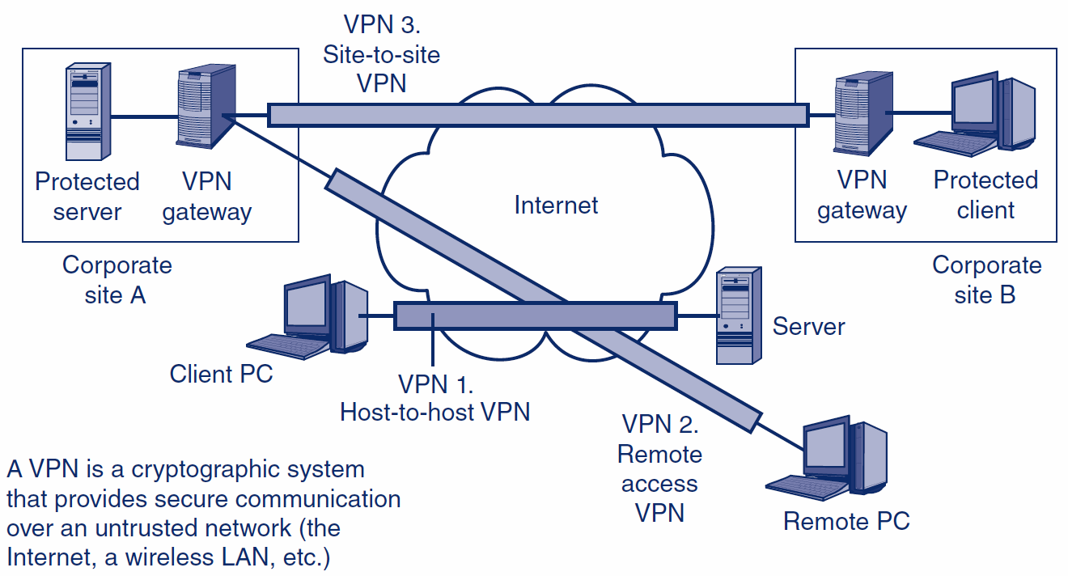
3.9: Virtual Private Networks (VPNs)

Slide 38
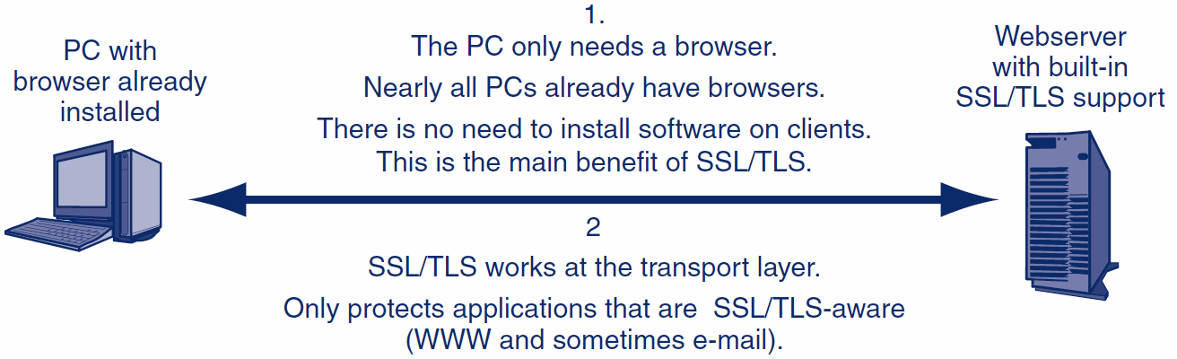
3.10: Host-to-Host SSL/TLS VPN

Slide 39
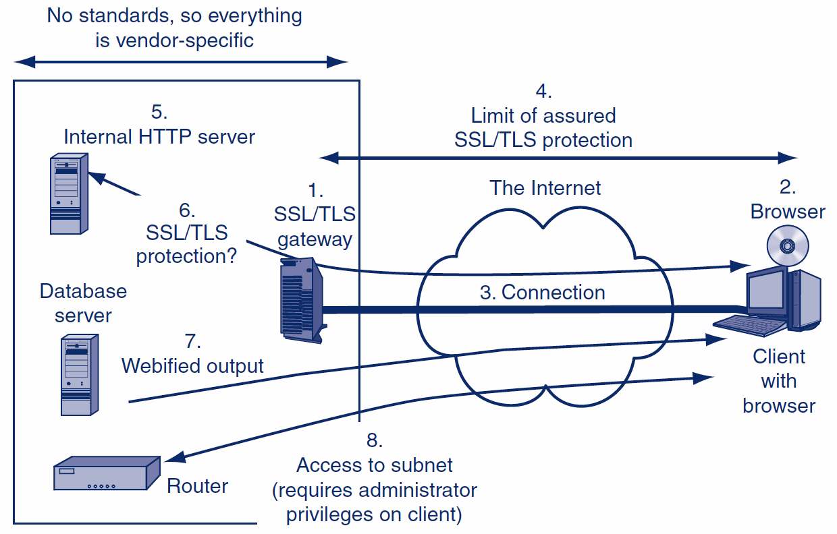
3.10: SSL/TLS and Remote Access VPN Using a Gateway

Slide 40
3.10: IP Security (IPsec) versus SSL/TLS
 | SSL/TLS | IPsec
Cryptographic security standard | Yes | Yes
Cryptographic security protections | Good | Gold Standard
Supports central management | No | Yes
Complexity and expense | Lower | Higher
Layer of operation | Transport | Internet
Transparently protects all higher-layer traffic | No | Yes
Works with IPv4 and IPv6 | NA | Yes
Modes of operation | NA | Transport, Tunnel

Slide 41
IPsec: Transport and Tunnel
Transport: host-to-host - secure within sites
Tunnel: site-to-site – secure between the sites

Slide 42
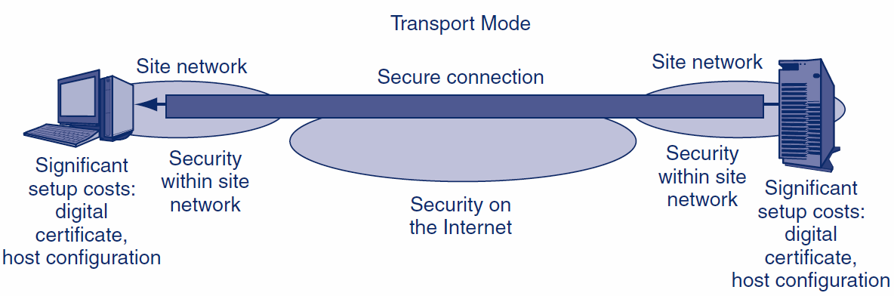
3.10: IPsec Operation: Tunnel and Transport Modes
1.
End-to-End
Security
(Good)
2.
Security in Site Network
(Good)
3.
Setup Cost
On Each Host
(Costly)

Slide 43
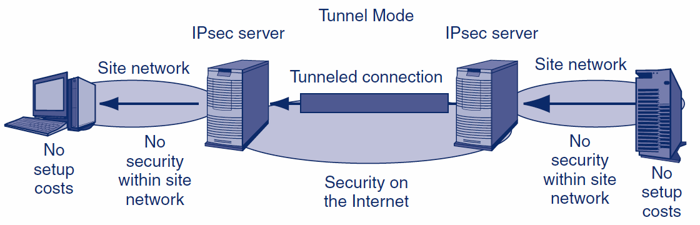
3.10: IPsec Operation: Tunnel and Transport Modes
2.
No Security in Site Network
(Bad)
3.
No Setup Cost
On Each Host
(Good)

Slide 44
3.10: Comparing IPsec Transport and Tunnel Modes
Characteristic | Transport Mode | Tunnel Mode
Uses an IPsec VPN Gateway? | No | Yes
Cryptographic Protection | All the way from the source host to the destination host, including the Internet and the two site networks. | Only over the Internet between the IPsec gateways. Not within the two site networks.
Setup Costs | High. Setup requires the creation of a digital certificate for each client and significant configuration work. | Low. Only the IPsec gateways must implement IPsec, so only they need digital certificates and need to be configured.

Slide 45
3.10: Comparing IPsec Transport and Tunnel Modes
Characteristic | Transport Mode | Tunnel Mode
Firewall Friendliness | Bad. A firewall at the border to a site cannot filter packets because the content is encrypted. | Good. Each packet is decrypted by the IPsec gateway. A border firewall after the IPsec gateway can filter the decrypted packet.
The “Bottom Line” | End-to-end security at high cost. | Low cost. Protects the packet over the most dangerous part of its journey.

Slide 46
The End

Slide 47
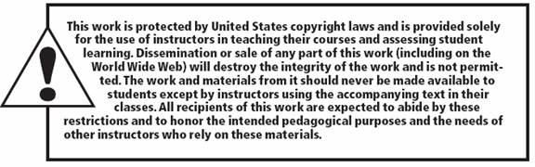
Copy right statement
All rights reserved. No part of this publication may be reproduced, stored in a retrieval system, or transmitted, in any form or by any means, electronic, mechanical, photocopying, recording, or otherwise, without the prior written permission of the publisher. Printed in the United States of America.
Copyright © 2015 Pearson Education, Inc.

